Slide 1

Pretrial Conferences
Small Claims
David E. Silverman
Brevard County Judge
davidsilverman.com

Slide 2

Small Claims Cases
Plaintiff
sues
Defendant
Up to $5,000
  Plus –
    Court Costs
    And if authorized by law or contract –
    Interest
    Attorney’s Fees

Slide 3
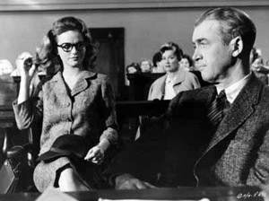
Purposes of Mediation
Sharing Perspectives
Clarifying Issues
Creating Alternatives
Reducing Trauma

Slide 4
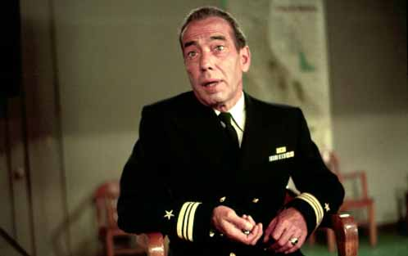
Mediation Guidelines
Voluntary Resolution
Privileged Communications
Respect Role of Mediator

Slide 5

Judgment
Upon receipt of said affidavit, without further notice or hearing, the Court shall enter a final judgment for plaintiff’s recovery from the defendant of the amount due or to become due under the stipulation, together with:
1. □ court costs to reopen the case.
2. □ interest on the balance due from the date of the default at _____% per year.
3. □ deferred prejudgment interest in the amount of $_____________.
4. □ reasonable attorney’s fees for reopening the case not to exceed $___________.
Settlement Form
Payment Terms
The defendant shall pay to the plaintiff the Total indicated above,
1. □ together with interest of _______% on the outstanding balance, payments being applied first to interest.
2. □ no interest on the Total unless defendant defaults in payment.
The defendant shall pay plaintiff $________________ monthly starting on _________________________ with each payment being due on the _______ day of each month.
Stipulation for Payment
The parties agree and stipulate to the following terms. The defendant shall pay the plaintiff, the following:
$_________for principal $_________for interest
$_________for costs $_________for attorney’s fees
Total $__________________________

Slide 6
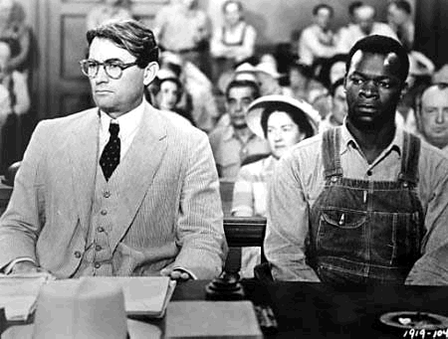
Pretrial Conference Order
Nature of the Claim
Time Reserved
Trial Date, Time and Place
Evidentiary Stipulations
Discovery Obligations

Slide 7
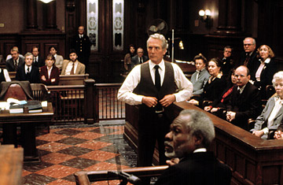
Trial
Witnesses
  Testimony
  Personal Knowledge
Documents
  Business Records
  Affidavits and Estimates

Slide 8
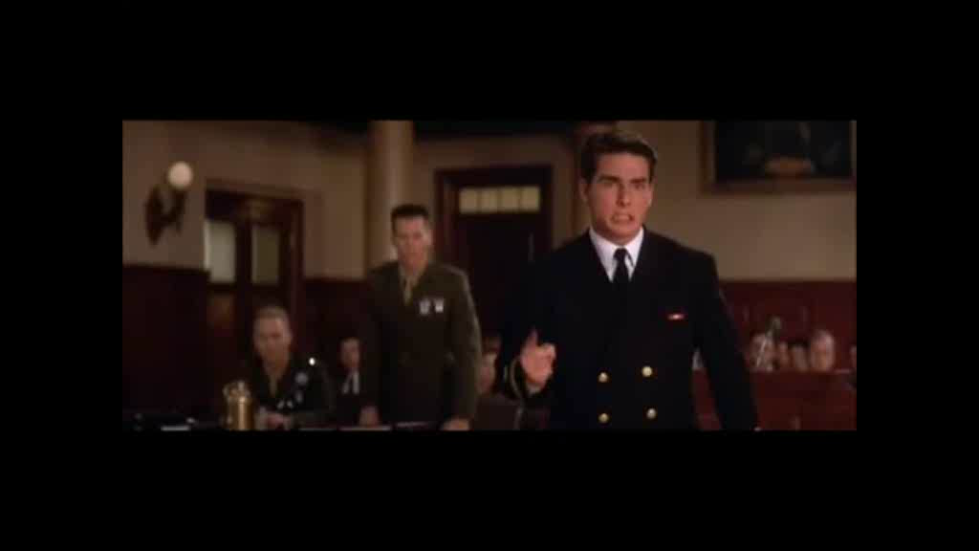
It is hereby ORDERED and ADJUDGED that the Plaintiff, [Plaintiff’s name], recover from Defendant, [Defendant’s name],
[Amount] for principal,
[Amount] for court costs, and
[Amount] for prejudgment interest,
for a total recovery of [Amount],
which shall bear interest at the rate established pursuant to § 55.03, Fla. Stat., until such time as this judgment is satisfied.
For all of the above sums let execution issue.
Judgment
It is hereby ORDERED and ADJUDGED that the Defendant shall complete a Form 7.343, Fact Information Sheet, under oath and return it to the [Plaintiff] [Plaintiff’s attorney] within 45 days of this Final Judgment, unless this Final Judgment is satisfied or a motion for new trial or notice of appeal is filed.

Slide 9
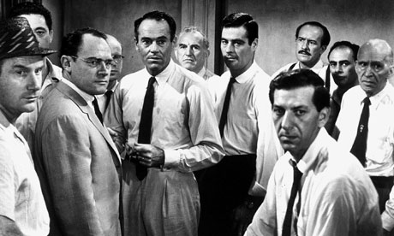
Collection
Levy
  Real Estate, Motor Vehicle
Garnishment
  Wages, Salary, Bank Accounts
Exemptions
  Homestead, Social Security,
  Head of Household, Other

Slide 10
Pretrial Conferences
Small Claims
David E. Silverman
Brevard County Judge
davidsilverman.com

